Slide 1



The Use of Dashboards in current business practice:
Enhancing cost estimation
Course: Research Methods and Professional Practice
Student Name: Rayyan Al Naqbi
ID: 32483

Slide 2
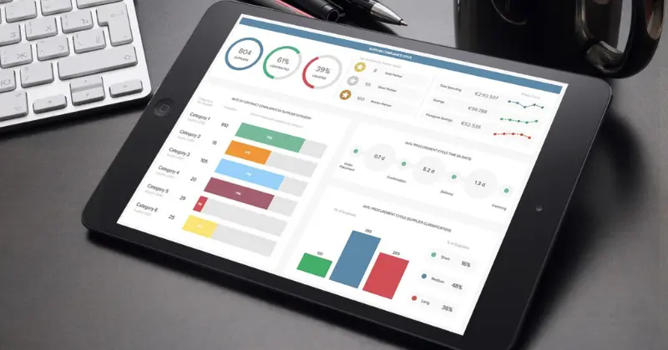


Introduction
Cost estimation underpins project financial success
Traditional estimation faces data fragmentation challenges
Dashboards enable real-time cost visibility
Study examines dashboards in business practice
01

Slide 3


Significance
Addresses gap between dashboards and estimation accuracy
Extends business intelligence application literature
Supports data-driven cost management practices
Contributes empirical insights to construction management
02

Slide 4

Research Problem Context
Frequent cost overruns persist in construction projects
Estimation relies on static, historical data
Limited real-time analytical decision support
Inefficient integration of cost information
03

Slide 5
Research Problem Knowledge Gap
Dashboard benefits remain underexplored empirically
Limited focus on estimation-specific dashboard impacts
Inconsistent dashboard adoption across organisations
Need evidence-based evaluation frameworks
04

Slide 6

Research Questions
How are dashboards currently applied within construction and real estate project environments?
What benefits and limitations of dashboard use have been identified in existing literature on construction and cost estimation?
In what ways do dashboards improve or influence cost estimation workflows in construction organisations?
To what extent do dashboards support predictive or analytical decision-making during the estimation process?
What gaps exist in current dashboard practices where AI-driven or advanced analytical dashboards could provide additional value??
05

Slide 7
Aim and Objectives
Evaluating current dashboard applications in construction.
Analyzing the benefits and limitations identified in the literature.
Examining how dashboards improve estimation workflows.
Exploring the extent to which dashboards support predictive or analytical decision-making.
Identifying gaps where AI-driven dashboards may provide new value.
06

Slide 8
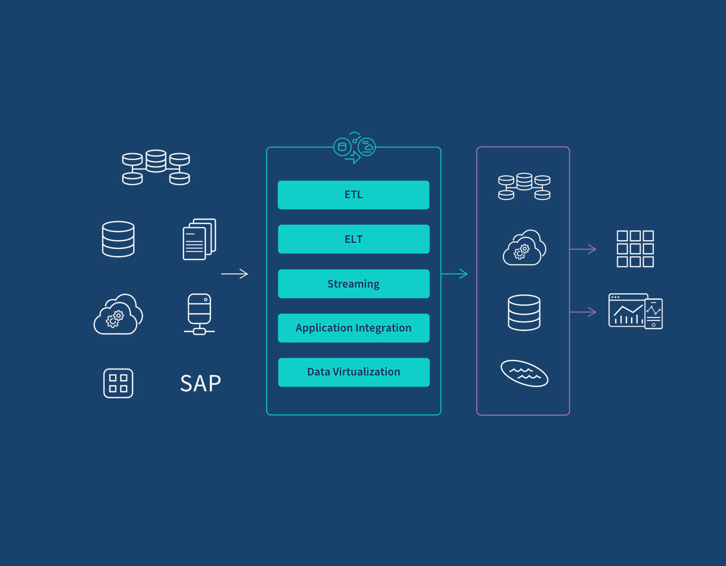
Key Literature Business Intelligence Foundations
Dashboards central to business intelligence systems
Enable data integration and visual analytics
Support managerial decision-making processes
Reduce uncertainty in cost-related decisions
07

Slide 9


Key Literature Dashboards in Cost Estimation
Integrate cost, schedule, procurement data
Enable real-time cost variance monitoring
Improve transparency of estimation processes
Enhance estimator collaboration and communication
08

Slide 10

Literature Benefits and Limitations
Improve reporting speed and accuracy
Reduce manual data handling errors
Limited by data quality issues
Require user skills and training
09

Slide 11

Key Literature Advanced Dashboards
Support forecasting and predictive cost analysis
Enable early identification of cost overruns
Underutilised due to technical complexity
Offer future research opportunities
10

Slide 12
Methodology – Research Approach
Positivist research philosophy adopted
Quantitative research approach applied
Focus on measurable relationships
Objective and replicable research design
11

Slide 13
Methodology – Research Design
Survey-based research design
Structured questionnaire using Likert scales
Target construction and real estate professionals
Purposive sampling strategy applied
12

Slide 14
Methodology – Data Analysis
Data analyzed using SPSS
Descriptive statistics summarise responses
Regression tests dashboard-estimation relationship
Findings presented in aggregated form
13

Slide 15
Ethical Considerations and Risk Assessment
Voluntary participation with informed consent
No personal or organizational identifiers
Secure data storage and confidentiality
Minimal risk to participants
14

Slide 16
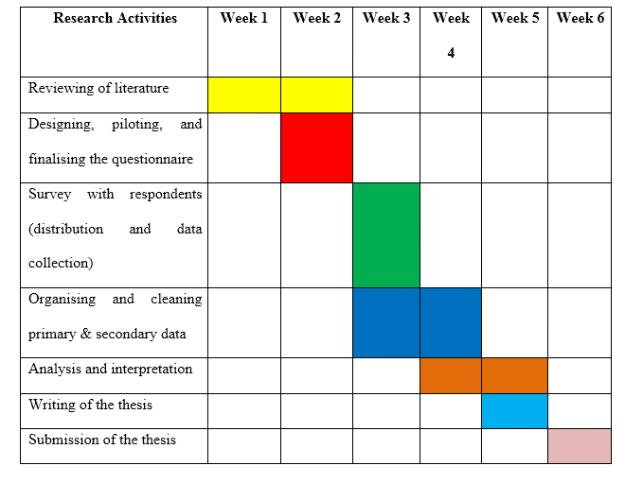
Timeline
15

Slide 17
THANK YOU
17

Slide 18
References list
Adeoye, M.A. (2024) Mastering the basics: A guide to research methodology for effective writing and publication. Chalim Journal of Teaching and Learning, 4(1), pp.30–41.
Available at: https://pasca.jurnalikhac.ac.id/index.php/cjotl/article/download/1345/462 (Accessed: 1/1/2026).
Ajax, R., Daniel, S. and Alex, W. (2025) AI for identifying cost overruns and anomalies.
Available at: https://www.researchgate.net/profile/Raymond-Ajax/publication/389680664_AI_for_Identifying_Cost_Overruns_and_Anomalies/links/67ccd307bab3d32d84402043/AI-for-Identifying-Cost-Overruns-and-Anomalies.pdf (Accessed: 2/1/2026).
Akter, M. and Kudapa, S.P. (2024) ‘A comparative analysis of artificial intelligence-integrated BI dashboards for real-time decision support in operations’, International Journal of Scientific Interdisciplinary Research, 5(2), pp.158–191.
Available at: https://ijsir.org/index.php/IJSIR/article/download/23/23 (Accessed: 6/1/2026).
Alshihri, S., Al-Gahtani, K. and Almohsen, A. (2022) ‘Risk factors that lead to time and cost overruns of building projects in Saudi Arabia’, Buildings, 12(7), p.902.
Available at: https://www.mdpi.com/2075-5309/12/7/902 (Accessed: 3/1/2026).
Cheong, H.I., Lyons, A., Houghton, R. and Majumdar, A. (2023) ‘Secondary qualitative research methodology using online data within the context of social sciences’, International Journal of Qualitative Methods, 22, p.16094069231180160.
Available at: https://journals.sagepub.com/doi/pdf/10.1177/16094069231180160 (Accessed: 11/1/2026).
Denscombe, M. (2025) ‘Decolonial research methodology: an assessment of the challenge to established practice’, International Journal of Social Research Methodology, 28(2), pp.231–240.
Available at: https://www.tandfonline.com/doi/pdf/10.1080/13645579.2024.2357558 (Accessed: 10/1/2026).
Dubey, U.K.B. and Kothari, D.P. (2022) Research methodology: Techniques and trends. Chapman & Hall/CRC.
Available at: https://amberton.edu/wp-content/uploads/2025/07/RGS6035_E2_Fall2025.pdf (Accessed: 1/1/2026).
Ibrahim, A.H. and Elshwadfy, L.M. (2021) ‘Factors affecting the accuracy of construction project cost estimation in Egypt’, Jordan Journal of Civil Engineering, 15(3).
Available at: https://www.researchgate.net/profile/Lamiaa-Mohamed-4/publication/353147794_Factors_Affecting_the_Accuracy_of_Construction_Project_Cost_Estimation_in_Egypt/links/60e9afeb30e8e50c01f79773/Factors-Affecting-the-Accuracy-of-Construction-Project-Cost-Estimation-in-Egypt.pdf (Accessed: 2/1/2026).
Naderi, M., Nazari, A., Shafaat, A. and Abrishami, S. (2025) ‘Enhancing accuracy in construction overhead cost estimation: a novel integration of activity-based costing and building information modelling’, Smart and Sustainable Built Environment, 14(3), pp.758–775.
Available at: https://researchportal.port.ac.uk/files/84969800/Enhancing_accuracy_in_construction_overhead_cost_estimation.pdf (Accessed: 6/1/2026).
Nia, S.B., Taheri, M. and Jamalpour, R. (2023) ‘Achieving realistic cost estimates in building construction projects: A reliability assessment of pre-construction stage cost estimates’, International Journal of Construction Engineering and Management, 12(3), pp.81–90.
Available at: https://www.researchgate.net/profile/Saeed-Bozorgmehr-Nia-2/publication/373138183_Achieving_Realistic_Cost_Estimates_in_Building_Construction_Projects_A_Reliability_Assessment_of_Pre-Construction_Stage_Cost_Estimates/links/64dbab80ad846e2882940f62/Achieving-Realistic-Cost-Estimates-in-Building-Construction-Projects-A-Reliability-Assessment-of-Pre-Construction-Stage-Cost-Estimates.pdf (Accessed: 3/1/2026).
Ojonugwa, B.M. et al. (2025) Integrated business performance monitoring models using Excel-based dashboards and manual controls.
Available at: https://www.allmultidisciplinaryjournal.com/uploads/archives/20250620152857_MGE-2025-3-336.1.pdf (Accessed: 11/1/2026).
Sayed, M., Abdel-Hamid, M. and El-Dash, K. (2023) ‘Improving cost estimation in construction projects’, International Journal of Construction Management, 23(1), pp.135–143.
Available at: https://www.researchgate.net/profile/Mohamed-Abdelhamid-4/publication/347361552_Improving_cost_estimation_in_construction_projects/links/6324458a0a70852150fb2022/Improving-cost-estimation-in-construction-projects.pdf (Accessed: 10/1/2026).
16

